Slide 1
FROM READING ROOMS TO VIRTUAL HUBS
Supporting Emerging Technology Research in the Archives
Alia Levar Wegner
Digital Collections Librarian
Walter Havighurst Special Collections
wegnera3@miamioh.edu

Slide 2
Challenges of Emerging Technology & Collaborative Research Models

Slide 3
The rhizome embodies a concept of breaking with hierarchical traditions of access to provoke serendipitous discovery through new connections and the coupling of past and present in innovative modes.
“
Duff, W.M., & Haskell, J. (2015). New uses for old records: A rhizomatic approach to archival access. The American Archivist, 78(1), 38-58.

Slide 4
ROWAN HALL TAKEOVER AT 50
Grant-funded project
Collaboration between 2 departments & special collections
Over 3 courses in 2 semesters, 2019-2020
Augmented reality experience of Rowan Hall Takeover, 15 April 1970
Occupation of Rowan Hall, 15 April 1970. Image: Walter Havighurst Special Collections & University Archives

Slide 5
USER NEEDS
Digital formats
Distributed access
Different research needs
Archival research
Design thinking
IP, copyright & privacy assistance
Early mockup of augmented reality layout in Armstrong Center, Miami University

Slide 6
LIMITS OF THE OUR READING ROOM
Reference service model
Incomplete collections
Discoverability challenges
Inaccessible media formats
Photo credit: Nick Kneer

Slide 7
Adapting to Emerging Technology & Collaborative Research Models

Slide 8
VIRTUAL HUB
Access
Provided infrastructure for the collaborative project
Digitized almost 990 images and documents
Added architectural documents from university units
Screenshot of Rowan Hall Takeover at 50 virtual hub

Slide 9
VIRTUAL HUB
Intellectual Property & Privacy
Used by Scholarly Communications staff and Office of General Counsel
Repository for source material not student work (FERPA)
Conducted copyright and privacy research for arrest photos
Rowan Hall arrest photo of E.F. Fitch, with permission. Photo credit: Ed Meador

Slide 10
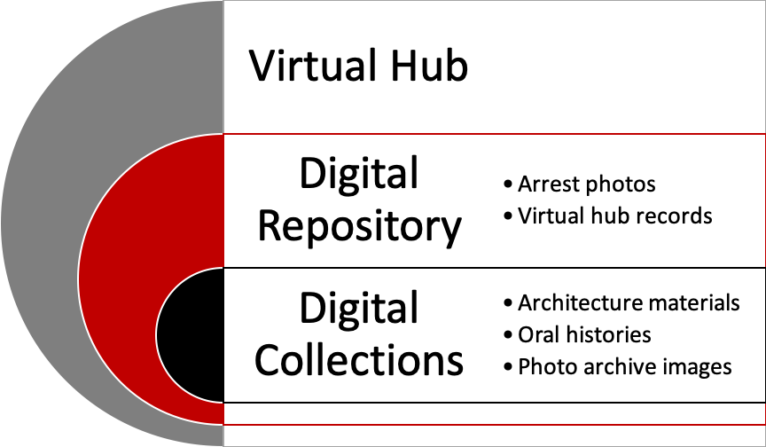
VIRTUAL HUB
Preservation

Slide 11
Supporting Emerging Technology & Collaborative Research Models

Slide 12
FINAL THOUGHTS
Create flexible infrastructure & access options
Reuse, remix, remediate
Incorporate maker literacies & competencies
New user studies
Student reading after Rowan Hall takeover, 1970

Slide 13
THANK YOU!
Alia Levar Wegner
Digital Collections Librarian
Walter Havighurst Special Collections
wegnera3@miamioh.edu

